Slide 1
Developing Kingdom Perspectives In The Marketplace
Bethesda Cathedral
13th Oct 2019

Slide 2
What is the Kingdom of God?

Slide 3
What is the Kingdom of God?
“For the kingdom of God is not a matter of eating and drinking but of righteous and peace and joy in the Holy Spirit.” Romans 14:17 (ESV)

Slide 4
What is the Kingdom of God?
God reigns and He is the sovereign.
He rules over the hearts & lives of those who submit to His authority willingly.
It’s both present and future.

Slide 5
What Is Kingdom Perspective?

Slide 6
What Is Kingdom Perspective?
“A Kingdom perspective is always in line with the Lord God's Word--His Constitution--and His Will for our lives. It is eternal and unchanging.”
W.R. Luchie (kingdomcitizens.org)

Slide 7
Kingdom Perspective
“Trust in the Lord with all your heart, And lean not on your own understanding; In all your ways acknowledge Him, And He shall direct your paths..” Proverbs 3:5-6 (NIV)

Slide 8
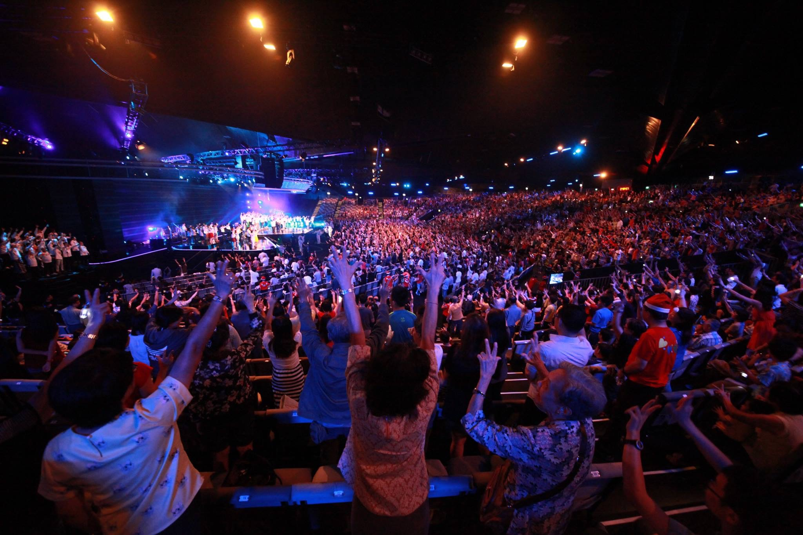
Love From The Stars Chinese Evangelical Concerts Dec 2015

Slide 9
Kingdom Perspective
“Be anxious for nothing, but in everything by prayer and supplication, with thanksgiving, let your requests be made known to God.” Philippians 4:6 (NKJV)

Slide 10
“I do my best, God do the rest”

Slide 11
Kingdom Perspective
“Faith without works is dead.” James 2:26 (KJV)

Slide 12
Serenity Prayer
“God, grant me the serenity to accept the things I cannot change, courage to change the things I can and wisdom to know the difference.”

Slide 13
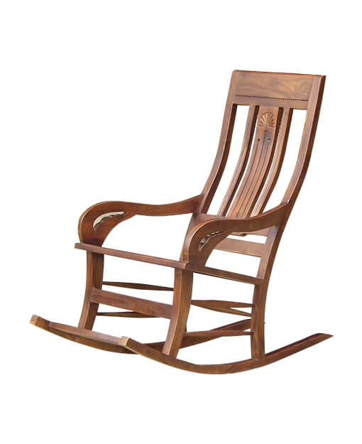
“Worrying is like sitting in a rocking chair. It gives you something to do but it doesn’t get you anywhere” English Proverb

Slide 14
Citizens of God’s Kingdom should:
Live by the Kingdom principles
Uphold a moral standard
Stand firm in our beliefs
Not lowering our standards to fit in
Inspire others around us
Notes:
1. Taken from the home page of Kingdom Citizens.
2. Citizens of God’s Kingdom should:
Live by the Kingdom principles
Uphold a moral standard
Stand firm in our beliefs
Not lowering our standards to fit in
Inspire others around us

Slide 15
How’s Kingdom of God @ Marketplace looks like?

Slide 16
God’s Kingdom @ Marketplace
Righteousness
Justice
Humility
Mutual respect
Peace

Slide 18
Starting With Ourselves

Slide 19
Developing Kingdom Perspective
Notes:
.

Slide 20
My Personal View On Work
“As a Christian, I see work as God Working through us to serve and take care of His creation, in particular human beings. Work therefore it’s a form of service that God allows us to perform for Him.”

Slide 21
Kingdom Perspective @ Work Is M.A.D

Slide 22
Colossians 3:23-24 (NIV)
“Whatever you do, work at it with your heart as working for the Lord, not for human masters, since you know that you will receive an inheritance from the Lord as a reward. It is the Lord Christ you are serving.”

Slide 23
Thank you & God Bless!

